Slide 1
Student Engagement & Retention Tool
Brenden Jones
Alexandré Northouse
Isaac McKinney

Slide 2
Brenden Jones
Where I am From: | Sheridan, IN
Age: | 21
Major: | I forget
Hobbies: | Lifting Chilling with my friends Shooting stuff

Slide 3
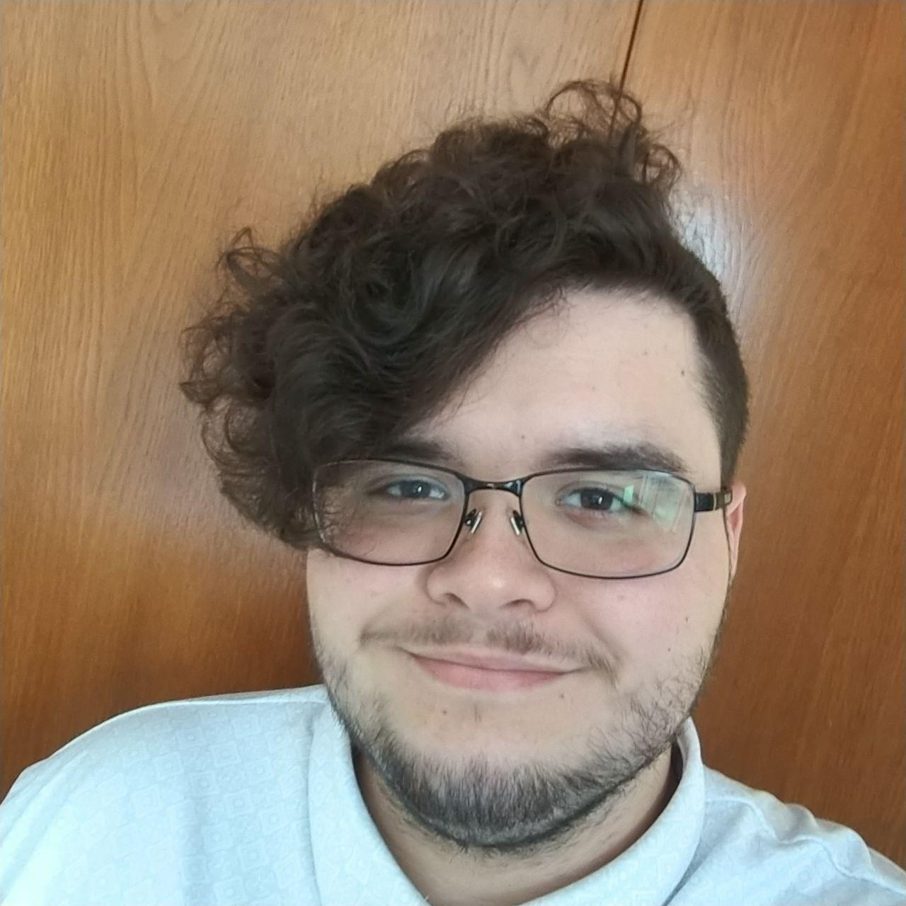
Alexandré Northouse
Where I am From: | Whiteland, Indiana
Age: | 21
Major: | Computer Science
Hobbies: | Board Games TV & Movies Youtube

Slide 4


Isaac McKinney
Where I am From: | Muncie, Indiana
Age: | 21
Major: | Computer Science
Hobbies: | Video Games Music Programming

Slide 5
Client
Notes:
Meeting was good, blah blah
2milli on the line
He wasn't down with the 6 hour per week granted by Indiana standards for college courses
Helped us narrow/sharpen our concept of the project
I personally found it somewhat easy, everyone was wanting to talk business and were asking good questions
Probably more preparation, better note taking on my part

Slide 6

Wesley Crouch
CEO of Tudr

Slide 7


Slide 8
First Meeting
Notes:
Meeting was good, blah blah
2milli on the line
He wasn't down with the 6 hour per week granted by Indiana standards for college courses
Helped us narrow/sharpen our concept of the project
I personally found it somewhat easy, everyone was wanting to talk business and were asking good questions
Probably more preparation, knowing what exactly what questions need answered while still paying attention to ask any questions I hadn’t considered, better note taking on my part

Slide 9
Student Engagement & Retention Tool

Slide 10
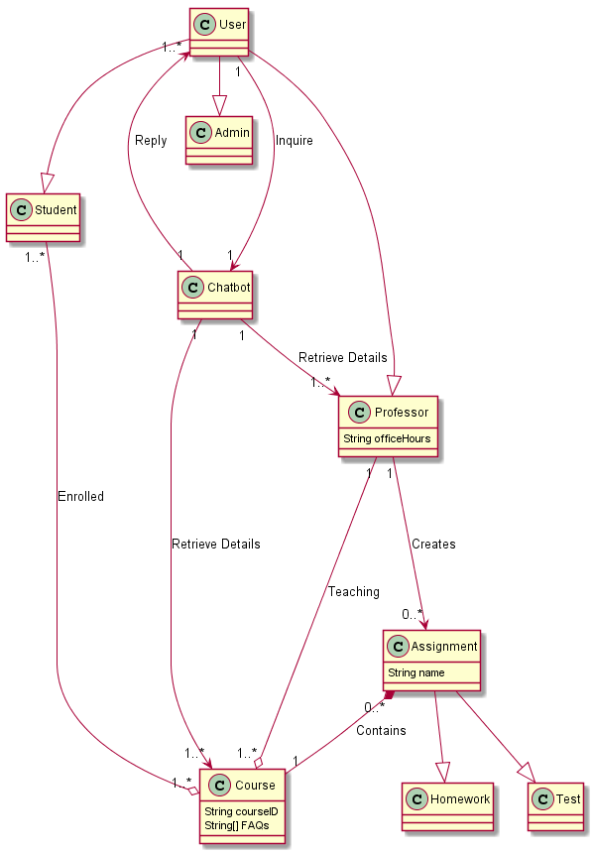
UML Graph

Slide 11
Text Stack
We will be using Firebase as the database
We will use Swift, HTML, CSS, Ruby on Rails and PostgreSQL
We will use AI as the chatbot

Slide 12
Project Goals
Dashboard
professor posts information
students can access information
Chat Bot
Using AI for interactions
Delivered through SMS

Slide 13
High-level features
Instructor can input data for HW-grades thresholds or commonly asked questions.
Student can message chatbot with questions like “Dr. Smith office hours”.
Chatbot can send messages regarding thresholds and due dates.

Slide 14
